Slide 1

SHOE HUNT
Shoe identifier app pitch – Jesse Hood

Slide 2

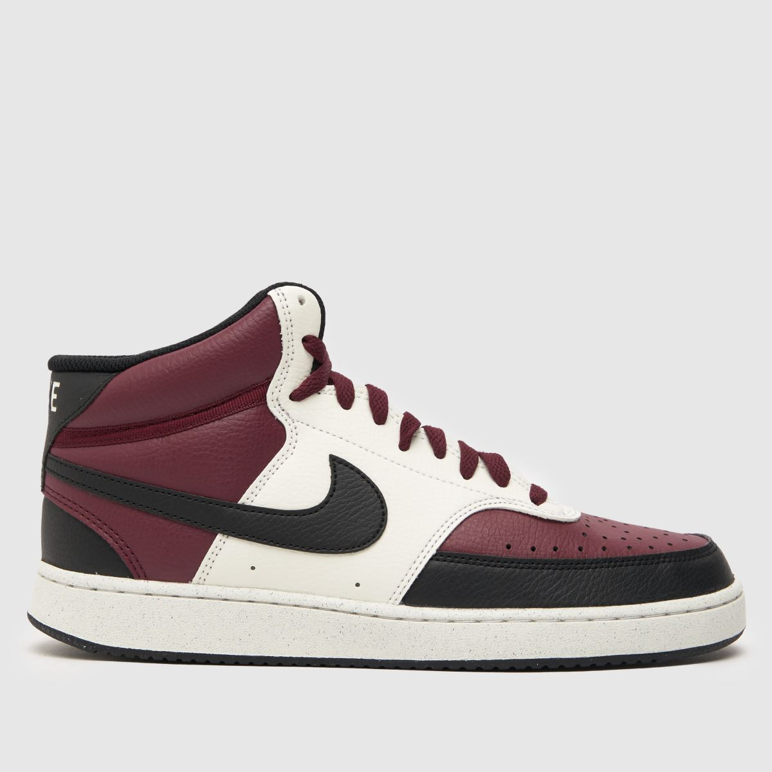
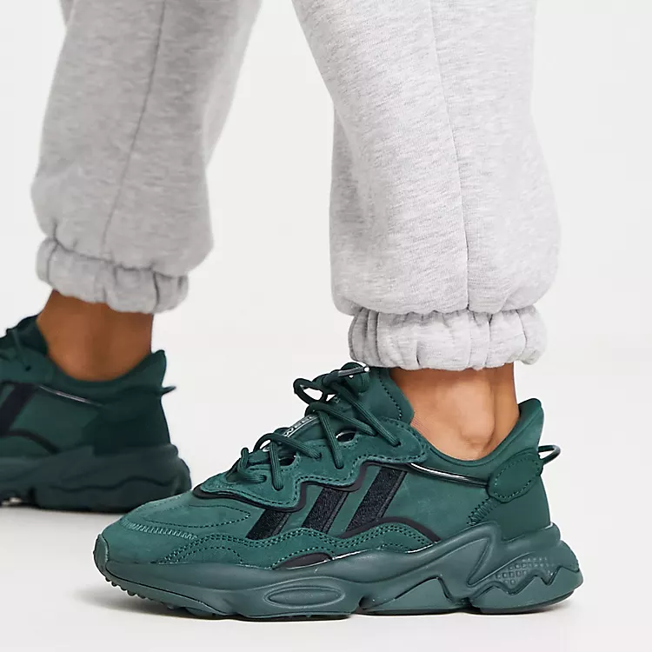
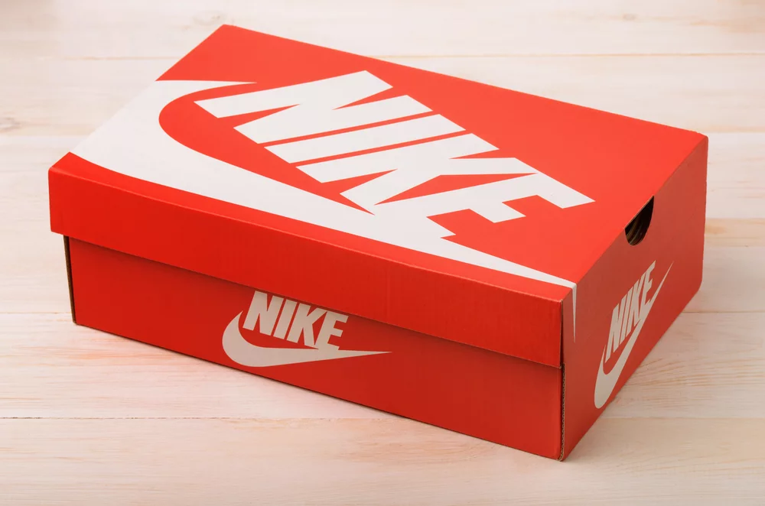
PITCH INTRO
If you want:
Shoes spotted in public for the best price
A perfect fit with every purchase
Early access to the latest big brand shoes
Quick, easy collection/delivery
You’ll love Shoe Hunt!

Slide 3
Why Shoe Hunt?
Different requirements, material choices for different shoe types (Highsnobiety, 2018) causes sizing imbalance
Approx. 64% of people wear shoes too narrow (Buldt, A.K. & Menz, 2018)
69% of people 16-24 buy clothes, shoes, accessories online (Statista, 2022)
76% of people “ look out for” offers & promotions when shopping (Statista, 2021)

Slide 4
How will it help?
Shoe Snaps – AI-powered visual search that finds shoes at different stores/prices
Size Profile – custom profiles to find perfect casual, training shoes etc.
Fresh Deals – special offer and promo codes exclusive to Shoe Hunt
On Trend –“big brand” release updates, style guides, celeb picks and other news
Journey Tracker – track recent purchases, including deliveries, pre-orders and collections
Customer Reviews – read and submit verified reviews

Slide 5
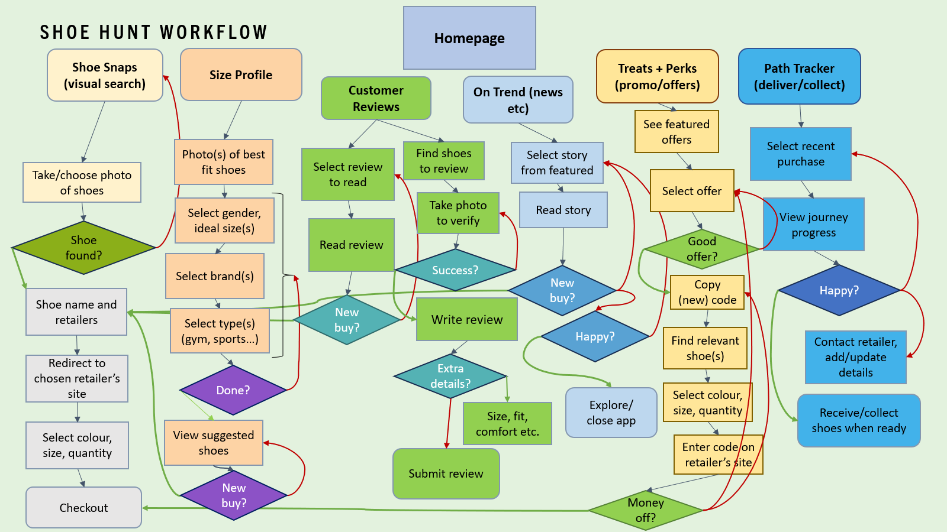

Slide 6
Monetisation means
Native ads promoting external offers (e.g. 20% off at adidas)
  Less intrusive compared to other ads – mimic app interface
Affiliate partnerships (e.g. Shoe Hunt x JD Sports)
  More control over promotion
  Profit guaranteed every time offer used
  Need to sell yourself to ideal partners

Slide 7

THANK YOU
Any questions?

Slide 8
References
Buldt, A.K. & Menz, H.B. (2018) 'Incorrectly fitted footwear, foot pain and foot disorders: a systematic search and narrative review of the literature,' Journal of Foot and Ankle Research, 11(1). [Accessed 31 October 2023]. Available from https://doi.org/10.1186/s13047-018-0284-z
Espinoza, J. (2023). A look at why sneaker sizes are inconsistent among different brands. [Accessed 31 October 2023]. Available from https://www.complex.com/sneakers/a/cmplxjoshua-espinoza/a-look-at-why-we-wear-different-sizes-in-different-shoes
Great Britain apparel e-purchases by demographic 2020 | Statista (2022). [Accessed 31 October 2023]. Available from https://www.statista.com/statistics/286096/clothes-and-sports-goods-online-purchasing-in-great-britain-by-demographic/
Statista (2021) Consumer attitudes towards pursuing special offers and promotions in the UK 2020. [Accessed 31 October 2023]. Available from https://www.statista.com/statistics/1126227/consumer-attitudes-pursuing-special-offers-and-promotions-in-the-uk/

